Slide 1
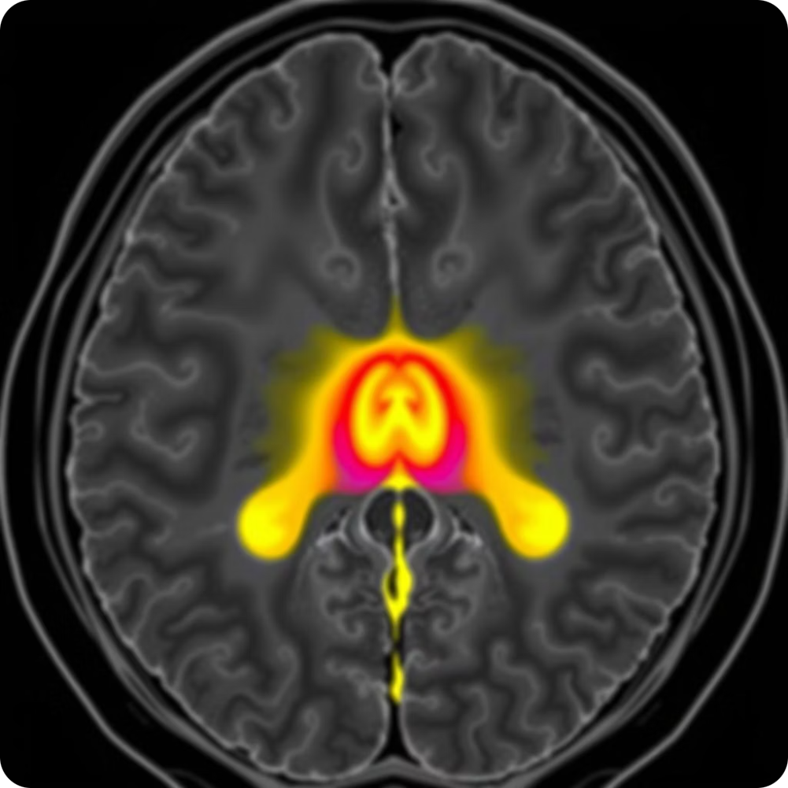
BRAIN TUMOR DETECTION SYSTEM
This AI-powered system uses deep learning to analyze MRI scans and detect brain tumors. It offers a user-friendly interface for uploading images, instant analysis, and downloadable PDF reports. Developed with advanced technologies, it aims to improve early and accurate diagnosis, reducing manual inspection errors and time. Presented by: Livingstone Mazvovere Exam Roll No: 22020107055

Slide 2

Project Overview and Timeline
1
Phase 1: Requirement Analysis and Data Collection
Week 1 focused on gathering necessary data and defining project requirements.
2
Phase 2 to 6: Development to Delivery
Weeks 2-6 covered data preparation, model development, UI design, deployment, and final testing.

Slide 3


Technologies and Setup
Core Technologies
Streamlit for web interface
OpenCV for image processing
YOLO (Ultralytics) for tumor detection
FPDF for PDF report generation
Installation Steps
Clone repository from GitHub
Create virtual environment
Install dependencies via pip
Run the app using Streamlit

Slide 4
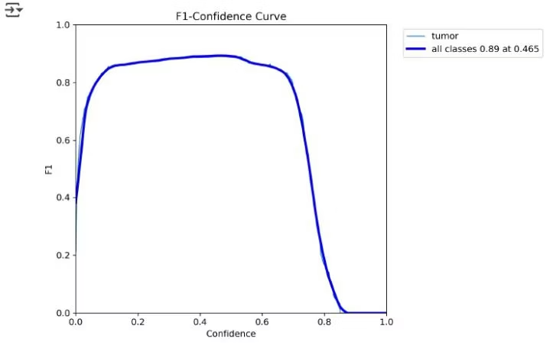
Model Training and Performance
Training Details
Performance Metrics
YOLOv11m model fine-tuned on 1500+ MRI scans over 20 epochs, achieving high accuracy and efficiency.
mAP@50: 92.1%
Precision: 91.4%
125 layers, 20M parameters
Recall: 87.4%
Training time: 0.668 hours
Model weights size: 40.5MB
Inference time: 24.9ms per image

Slide 5
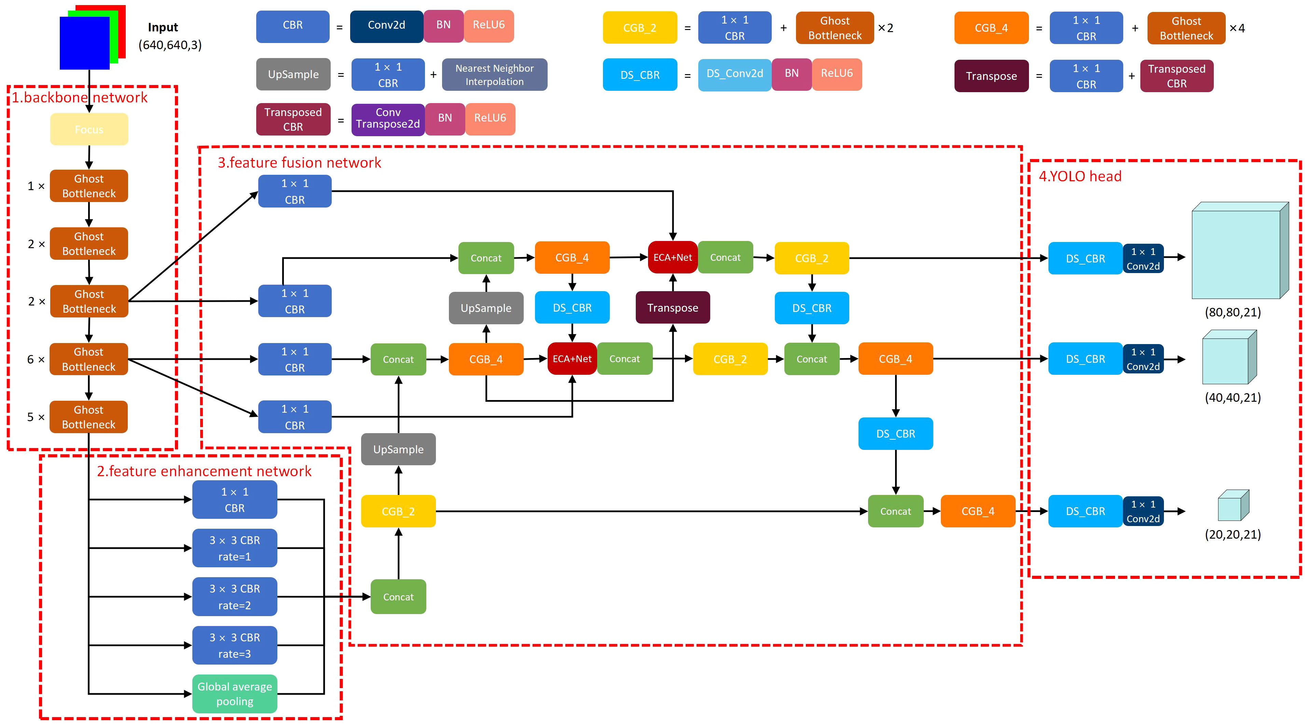
Model Architecture and System Design
1
Data Input Module
Handles MRI scan uploads and preprocessing.
2
Detection Engine
Performs tumor detection using the YOLOv11m model.
3
Visualization Module
Highlights detected tumors with bounding boxes on images.
4
Reporting Module
Generates downloadable PDF diagnostic reports.

Slide 6

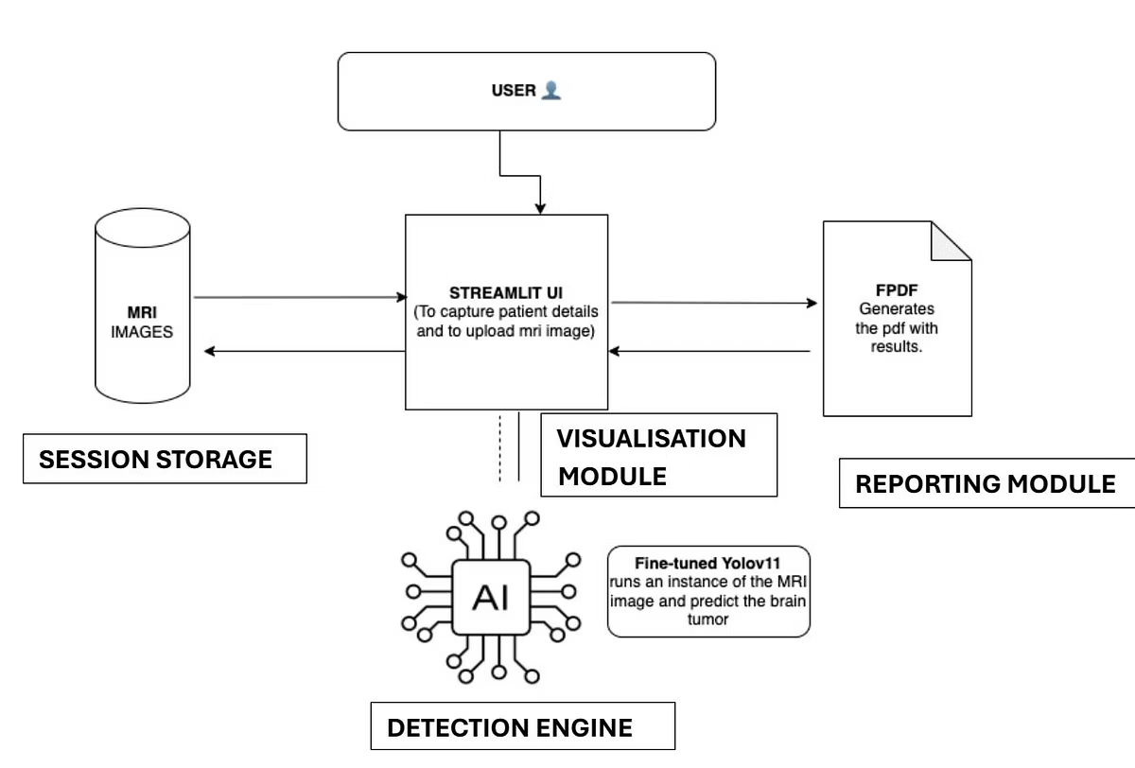


User Guide and Technical Implementation
User Steps
Enter patient details
Upload MRI scan
View tumor detection results
Download report
Technical Details
Image preprocessing includes resizing and normalization. Detection uses YOLOv11m. Streamlit renders UI and FPDF generates reports.

Slide 7
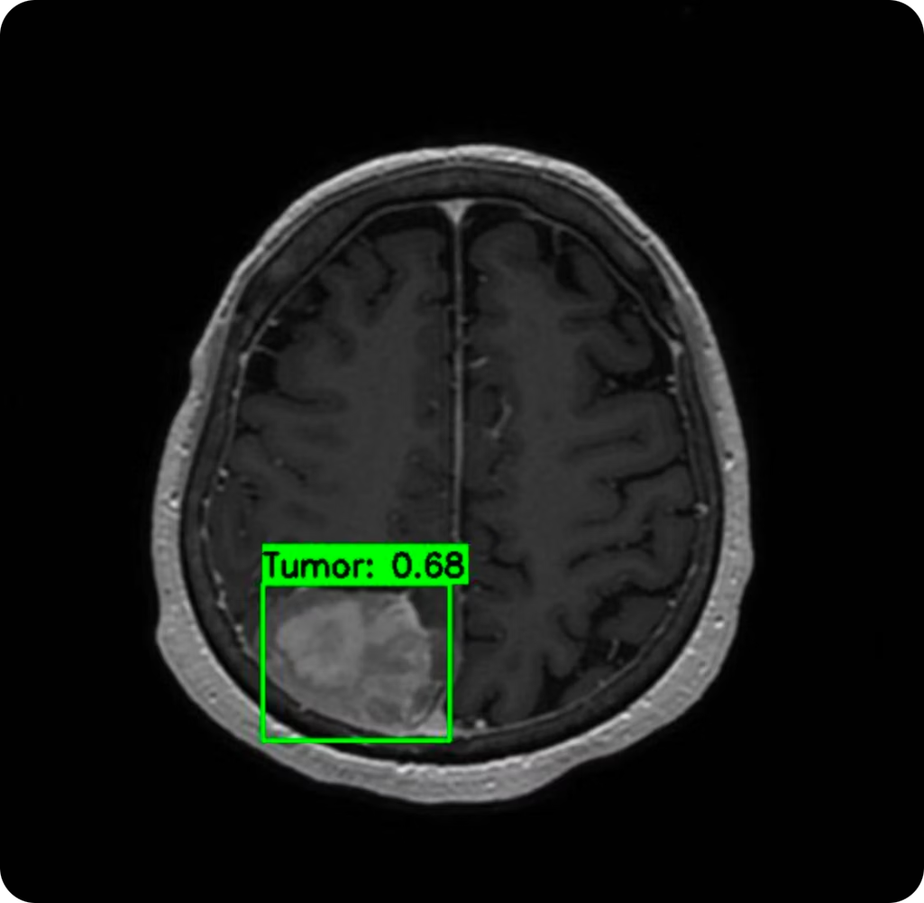
Detection Results and Output
Report Highlights
Includes patient info, tumor locations, confidence scores, and classification (benign/malignant).
Disclaimer
AI-generated reports assist diagnosis but require review by licensed medical professionals.

Slide 8
Conclusion and Future Enhancements
1
Conclusion
Deep learning enables accurate, real-time brain tumor detection, supporting early diagnosis and aiding radiologists.
2
Future Enhancements
3D MRI support
Attention mechanisms
Mobile app version
DICOM server integration
Expert feedback tools

